Slide 1


IMAGINE – Tourist Guide Matching Platform
13/11/2025

Slide 2
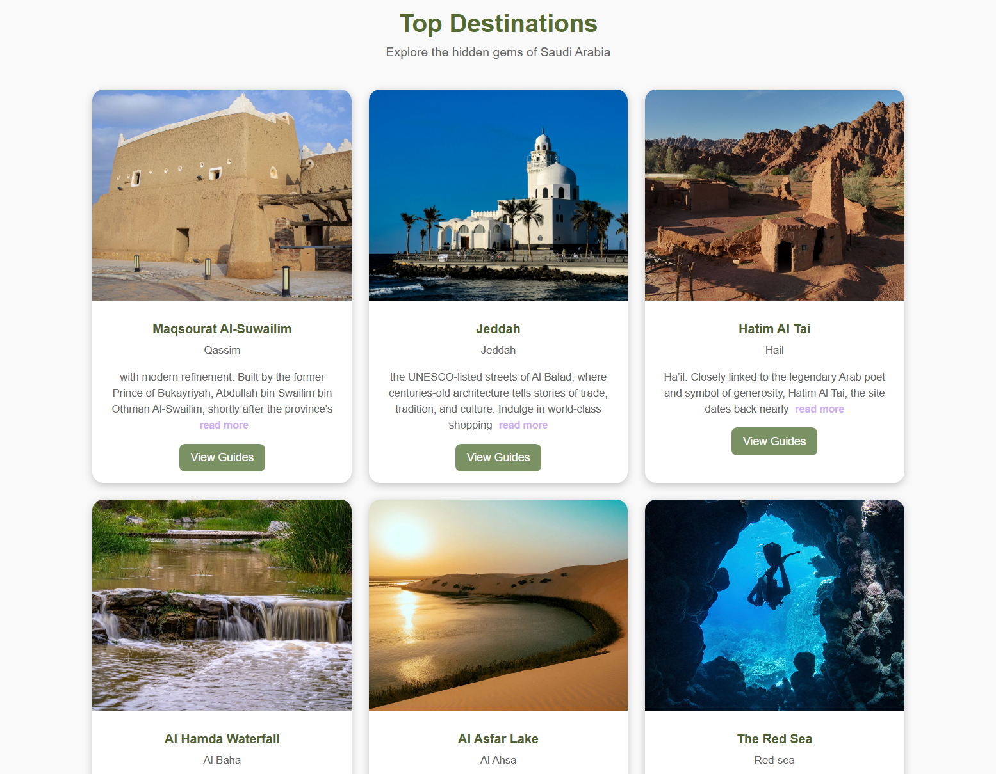
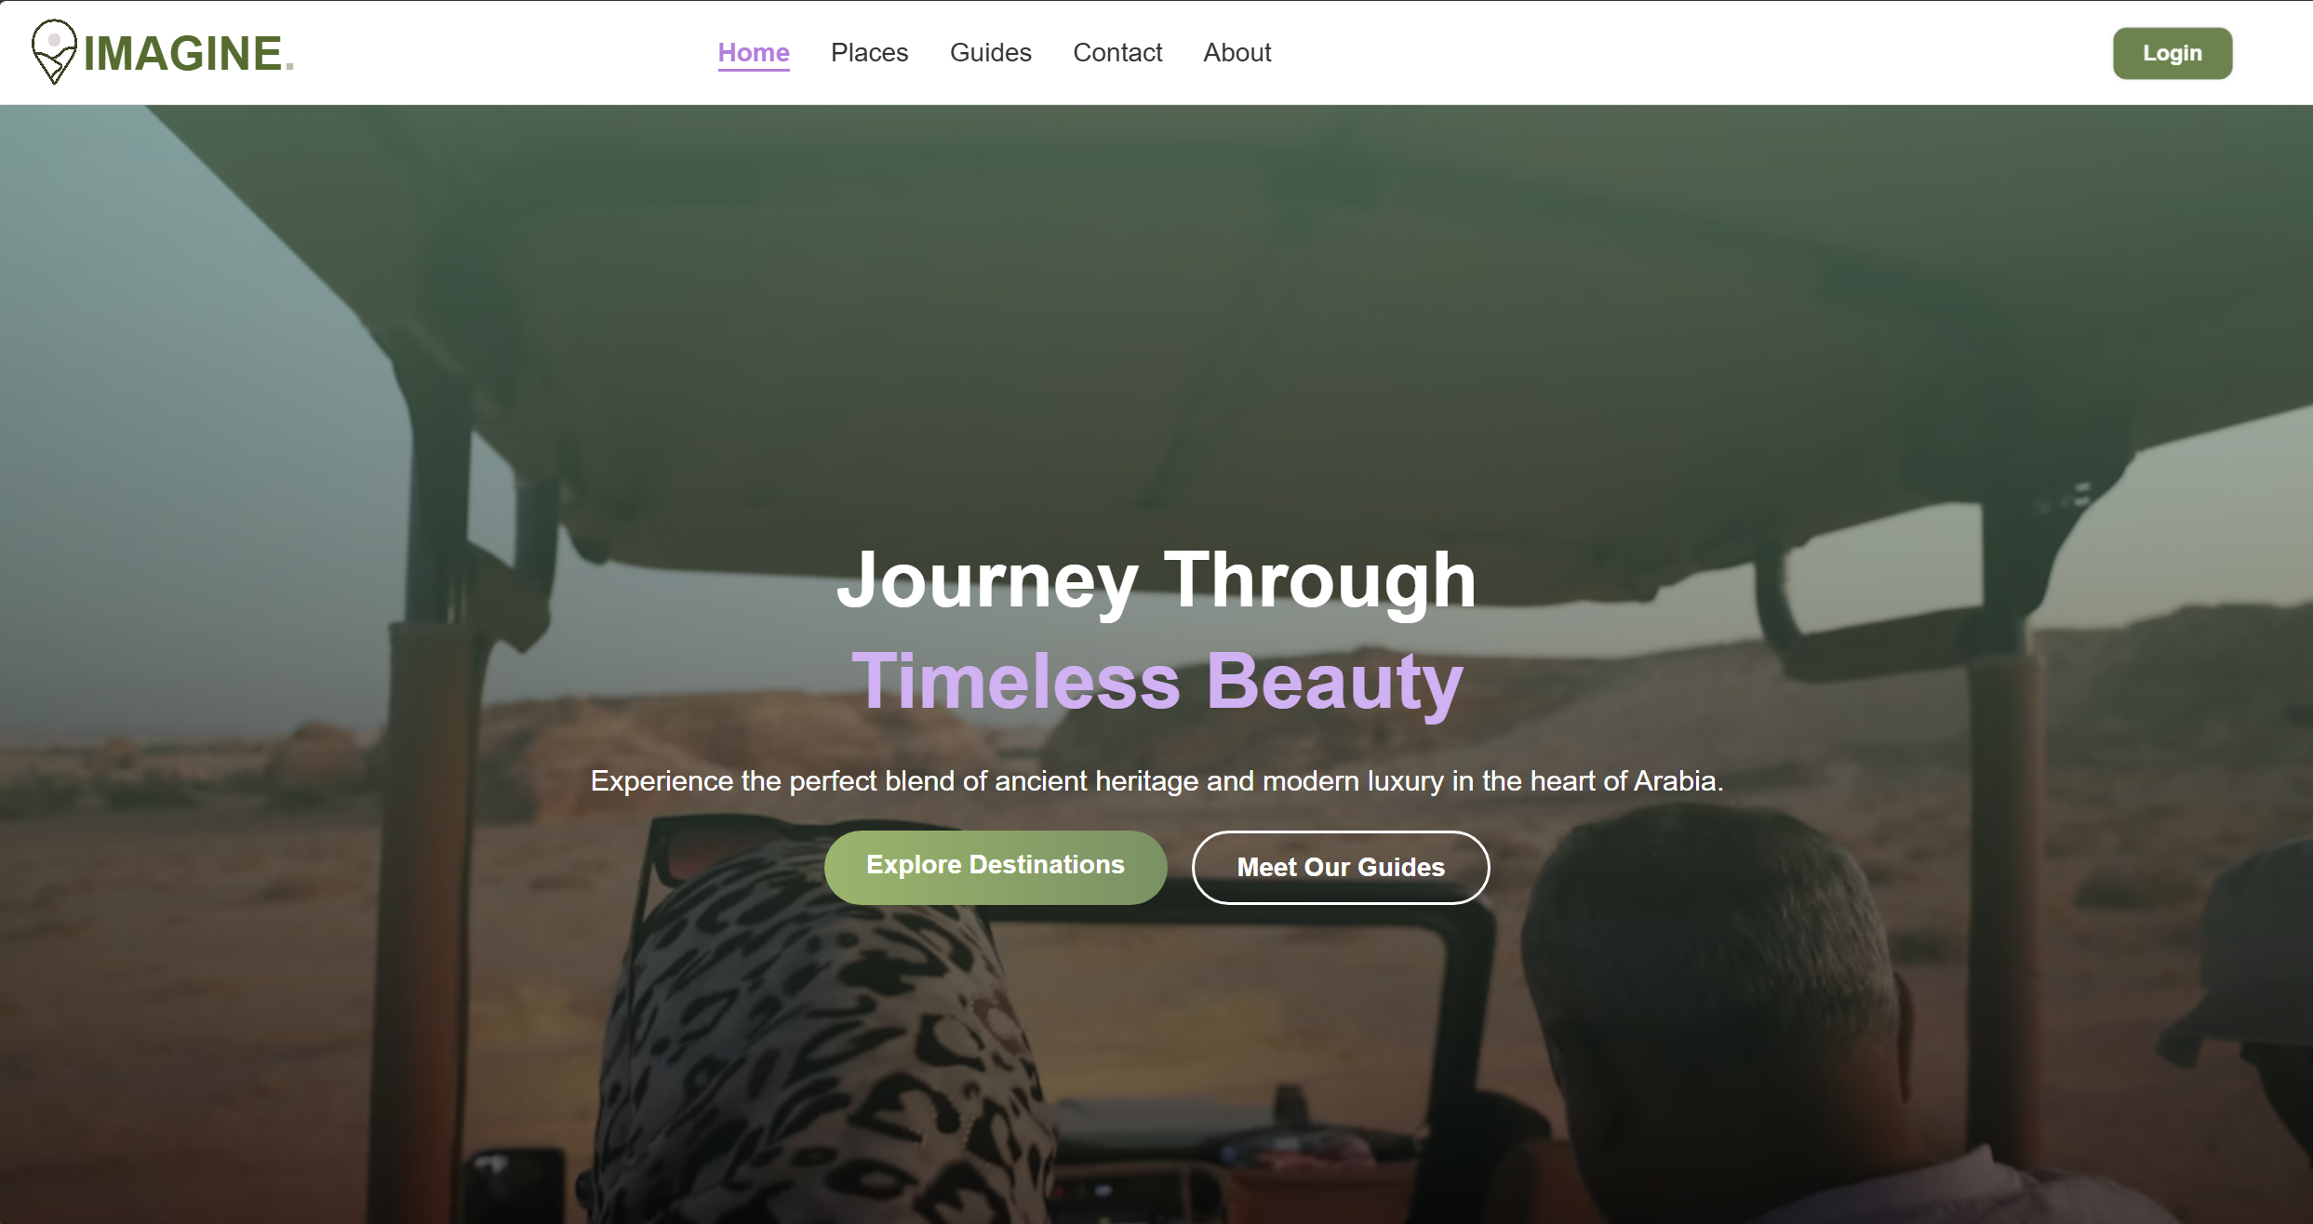
MVP Scope:
Home page explaining the value of the platform.
Places page to showcase main destinations (e.g., AlUla, Red Sea, Riyadh).Challenges & Problems
Guides page to list tour guides.
Become a Guide form to submit guide details and license.
Admin Login entry point.

Slide 3

Key Learnings
Focus on MVP enabled a working version within the deadline.
Pivot to Supabase reduced backend setup (Authentication, Tables, Storage) and allowed faster progress.
Team collaboration remained consistent despite time constraints.
Improvements for Future Projects.
Choose a Tech Stack aligned with team skills and timeline from the start.
Allocate clear time for Testing, Bug Fixing.
Clarify external requirements early and reflect them in the plan.

Slide 4
Front-end: HTML / CSS / JavaScript (static site).
Back-end: Supabase (Authentication, Tables, Storage ).
Hosting: Front-end on Netlify.
Technical Architecture

Slide 5
Add Payments for online transactions.
Multi-language support for international tourists.
Launch a simple marketing plan (social media presence, tourism-focused content, outreach to guides).
Next Steps

Slide 6
Django complexity under tight timelines and additional external requirements.
Time pressure and overlapping tasks.
Limited real-user testing and low initial traffic for a new site.
Challenges & Problems

Slide 7

Team Members
Riyadh Alhamad
Mohammed Alqabas
Nasser Alqahtani

Slide 8
Thank You!

